Slide 1
GeoComputation with R
Lightning Talk
Shrujan Varma Penmetsa
(UNI – sp4155)

Slide 2
Why is geographic visualization crucial ?
Geographic data is everywhere.
Effective visualization of geographic data helps to communicate insights with relative ease.
Example:
I am from Pune, a city in India.
I am studying at Columbia University in New York
It is my dream to see the Northern Lights in Iceland.
What is GeoComputation:
GeoComputation is about using the various different types of geodata and about developing relevant geo-tools within the overall context of a 'scientific' approach (Openshaw and Abrahart,2000).
Several GIS software have limited accessibility
Harness the power of modern computers to do ‘things’ with data.

Slide 3
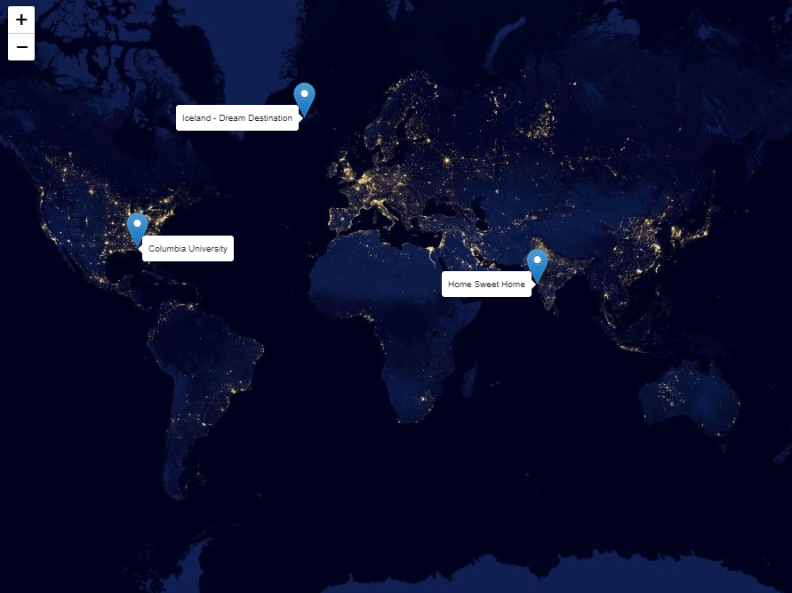
Visualization of the example mentioned in the previous slide:

Slide 4
How many lines of code were required for the above graph?
Answer – 5
Which package was used to deliver the graph?
Answer – Leaflet
What is Leaflet?
The most important type of interactivity, however, is the display of geographic data on interactive or ‘slippy’ web maps. The release of the leaflet package in 2015 revolutionized interactive web map creation from within R.
It’s used by websites ranging from The New York Times and The Washington Post to GitHub and Flickr
Interactive panning/zooming
Compose maps using arbitrary combinations of:
Map tiles
Markers
Polygons
Lines
Popups

Slide 5
How do these packages deal with data?
There are 2 types of geographic data models: vector and raster.
The vector data model represents the world using points, lines, and polygons. These have discrete, well-defined borders, meaning that vector datasets usually have a high level of precision
The raster data model divides the surface into cells of constant size. Raster datasets are the basis of background images used in web mapping and have been a vital source of geographic data since the origins of aerial photography and satellite-based remote sensing devices.
Other important packages in R :
sf
sp
tmap
We will now be using a spatial object “world” which is a part of the “spData” package, containing spatial and attribute columns.

Slide 6
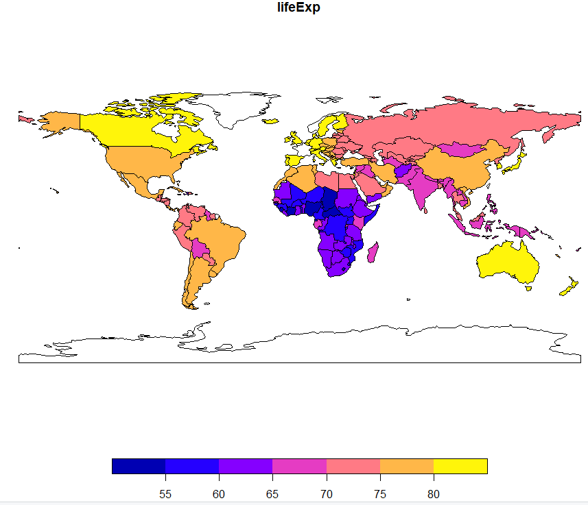
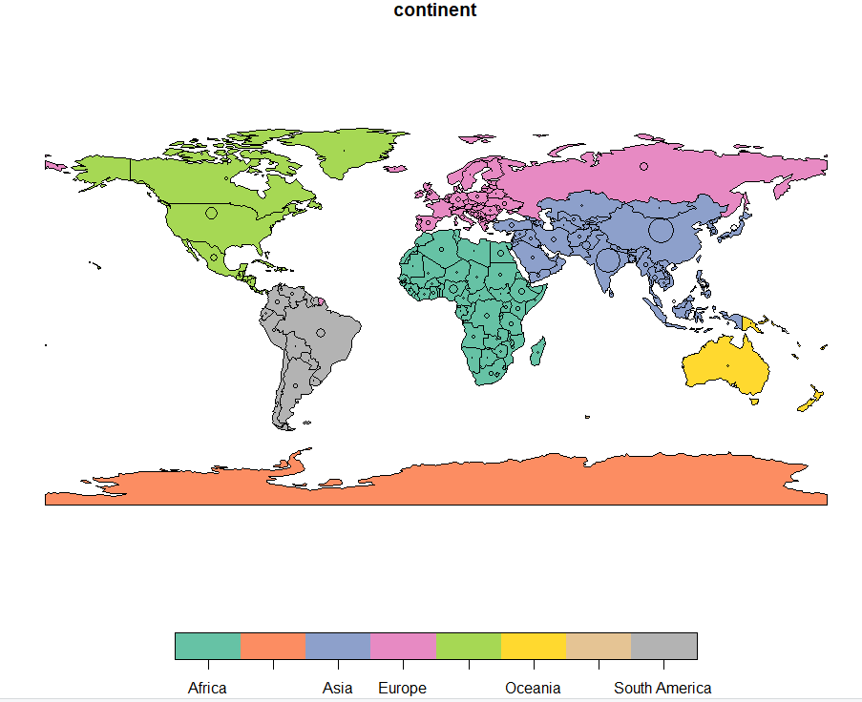
Basic maps are created in sf with plot()
Here, we have simply plotted the “lifeExp” attribute (Life expectancy of all the countries) of “world” using plot()
The above plot illustrates the flexibility in sf package by overlaying circles, whose diameters (set with cex =) represent country populations, on a map of the world.

Slide 7
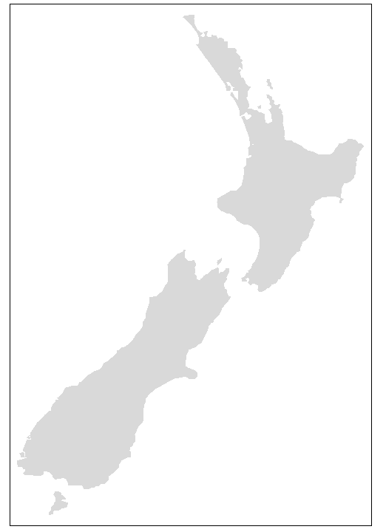
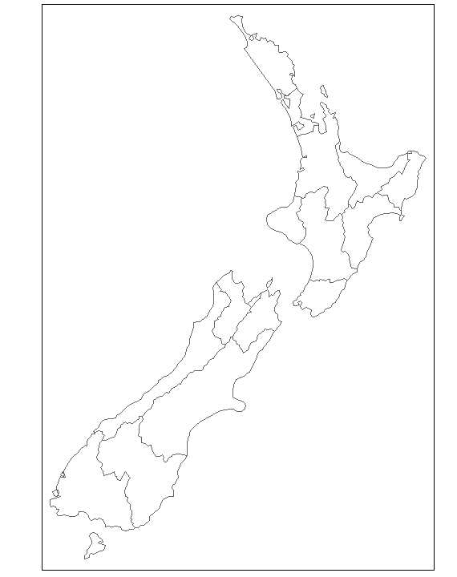
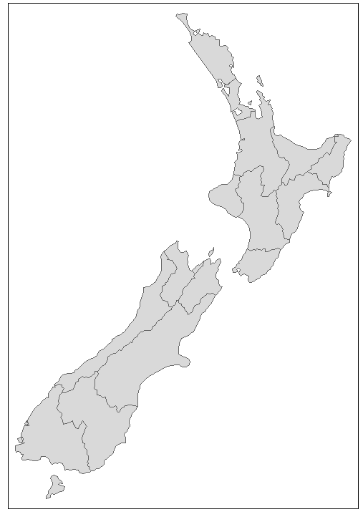
Another important package: tmap
tmap is a powerful and flexible map-making package with sensible defaults.
It has a concise syntax that allows for the creation of attractive maps with minimal code which will be familiar to ggplot2 users.
It also has the unique capability to generate static and interactive maps using the same code via tmap_mode().
The basic building block is tm_shape() (which defines input data, raster and vector objects).
The object passed to tm_shape() in this case is nz, an sf object representing the regions of New Zealand
tm_shape(nz) + tm_fill()
tm_shape(nz) +tm_borders()
tm_shape(nz)+tm_fill() + tm_borders()

Slide 8
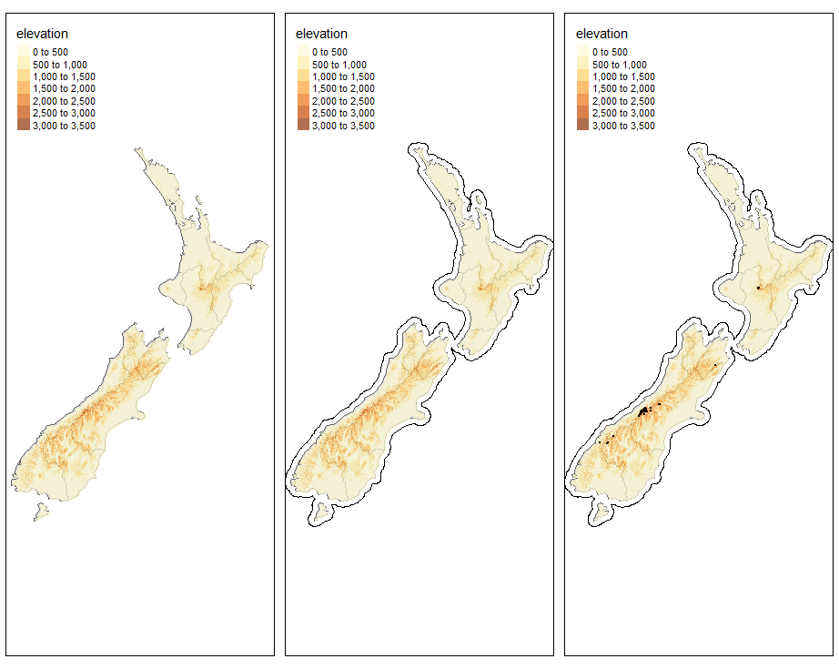
New shapes can be added with + tm_shape(new_obj). In this case new_obj represents a new spatial object to be plotted on top of the preceding layers.
Here, new_obj is nz_elev and nz_water , which represents the region elevations and territorial waters in New Zealand
Fig(a) = 2 Layers of tm_shape + raster layer
Fig(b) = fig(a) + tm_lines (for outline)
Fig(c) = fig(b) + tm_dots (dots represent the highest points)

Slide 9
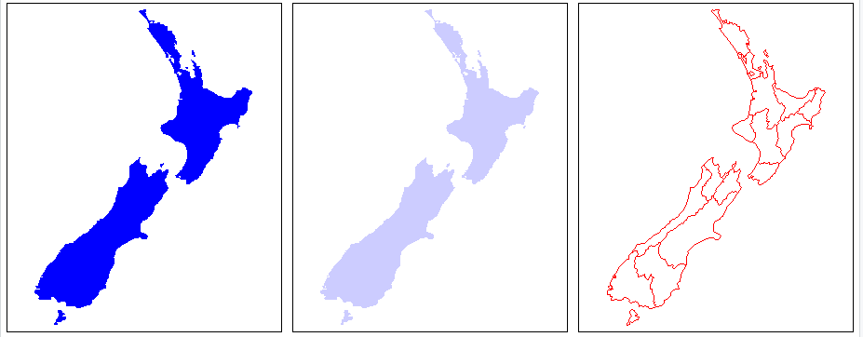
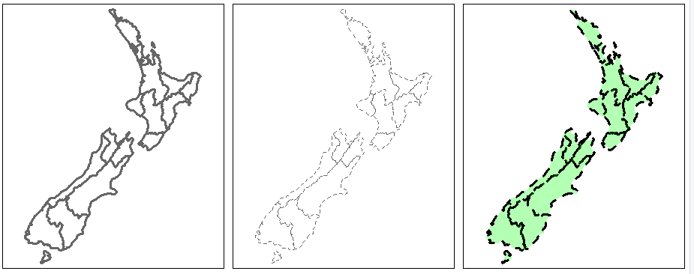
Aesthetic Settings:
There are two main types of map aesthetics: those that change with the data and those that are constant.
Unlike ggplot2, which uses the helper function aes() to represent variable aesthetics, tmap accepts aesthetic arguments that are either variable fields (based on column names) or constant values.
tm_fill tm_fill with gradient tm_border tm_border with lwd tm_border with lty tm_fill + tm_border

Slide 10
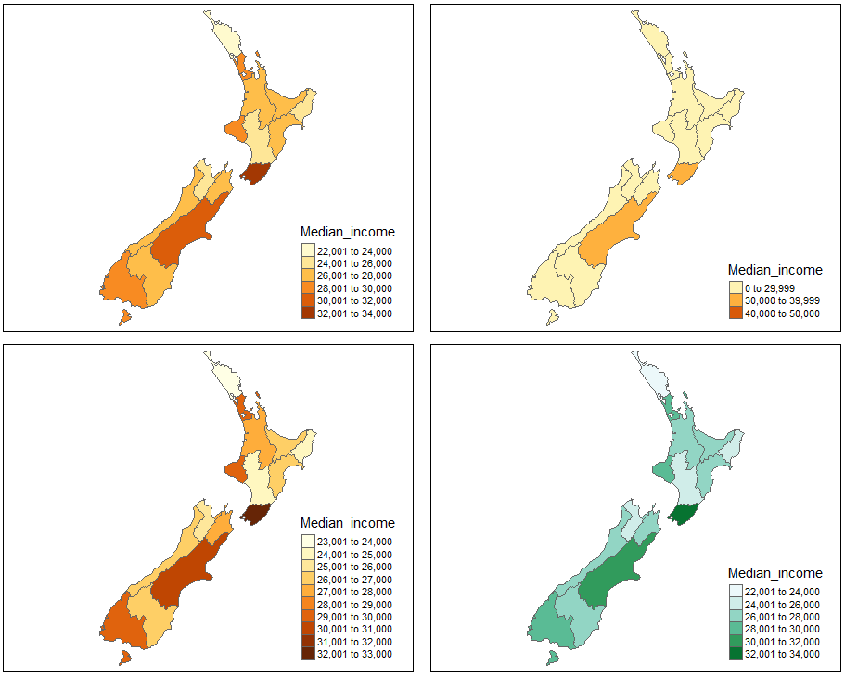
Colour Settings :
Color settings are an important part of map design. They can have a major impact on how spatial variability is portrayed.
“breaks” allows you to manually set the breaks
n sets the number of bins into which numeric variables are categorized
palette defines the color scheme, for example, BuGn
Colour on basis of median_income breaks = 3
n = 10 palette = BuGn

Slide 11
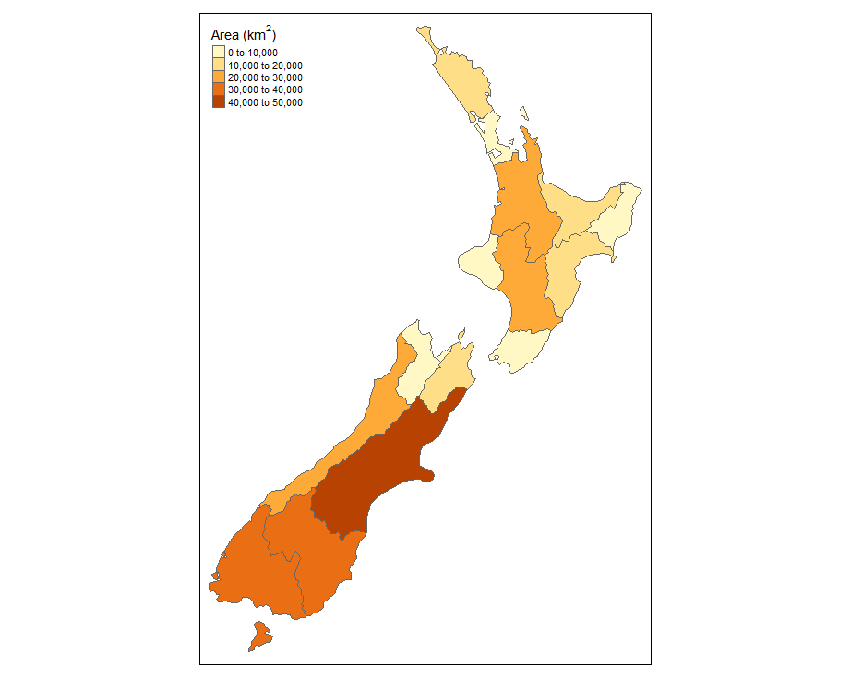
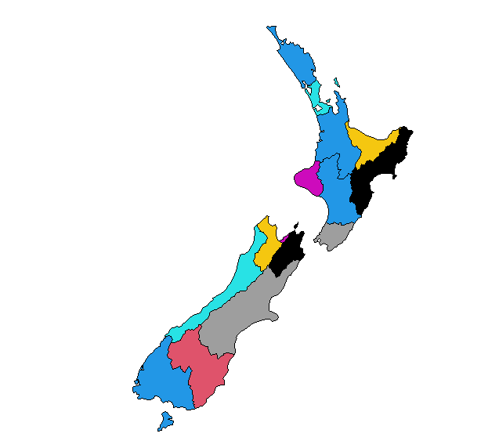
Amateur Plot Plot created after Shrujan’s Lightning Talk

Slide 12
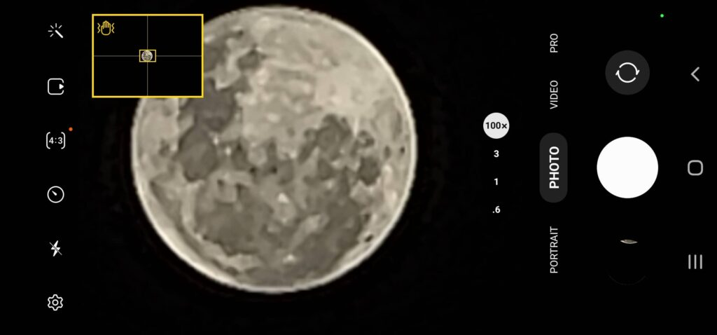
Inset Maps:
An inset map is a smaller map rendered within or next to the main map.
It could serve many different purposes, including providing a context or bringing some non-contiguous regions closer to ease their comparison.
They could be also used to focus on a smaller area in more detail or to cover the same area as the map, but representing a different topic.
Camera interface in the latest S22 Ultra while zooming 100x. Zoomed in Maps can be created using a similar layout.

Slide 13
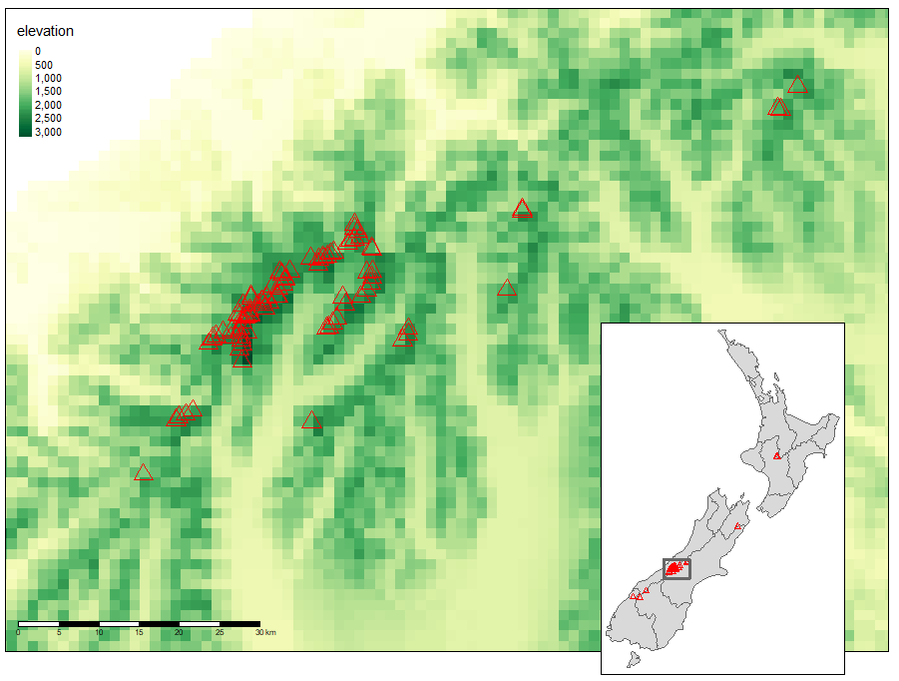
Steps:
The first step is to define the area of interest
In the second step, we create a base map showing the New Zealand’s Southern Alps area
The third step consists of the inset map creation. It gives a context and helps to locate the area of interest
Finally, we combine the two maps using the function viewport() from the grid package
An inset map showing the highest peaks of NZ.

Slide 14
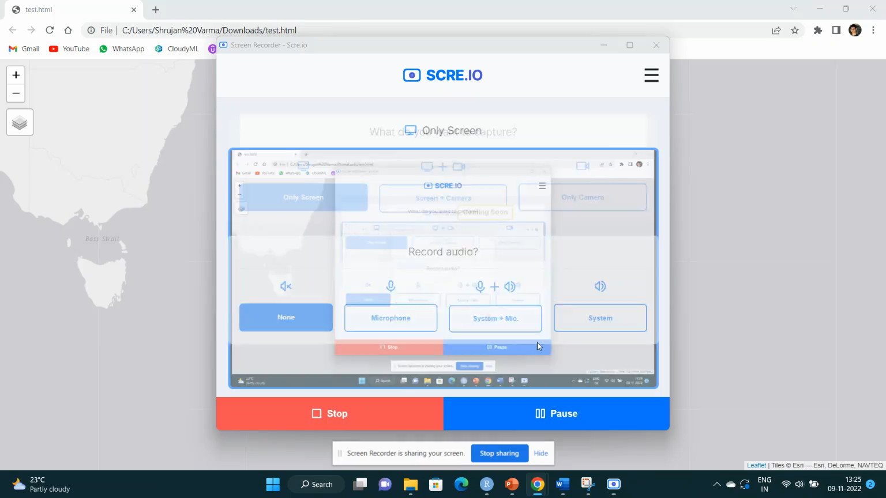
Interactive Maps:
Interactivity can take many forms, the most common and useful of which is the ability to pan around and zoom into any part of a geographic dataset overlaid on a ‘web map’ to show context.
Less advanced interactivity levels include popups that appear when you click on different features, a kind of interactive label. More advanced levels of interactivity include the ability to tilt and rotate maps

Slide 15
How many lines were required for the interactive map ?
Answer – 1
Interactive maps using tmap package:
A unique feature of tmap as mentioned previously is its ability to create static and interactive maps using the same code.
Maps can be viewed interactively at any point by switching to view mode, using the command tmap_mode("view").
Leaflet package can also be used to create interactive maps :
Last but not least is leaflet which is the most mature and widely used interactive mapping package in R.
Leaflet maps are created with leaflet(), the result of which is a leaflet map object which can be piped to other leaflet functions. This allows multiple map layers and control settings to be added interactively

Slide 16
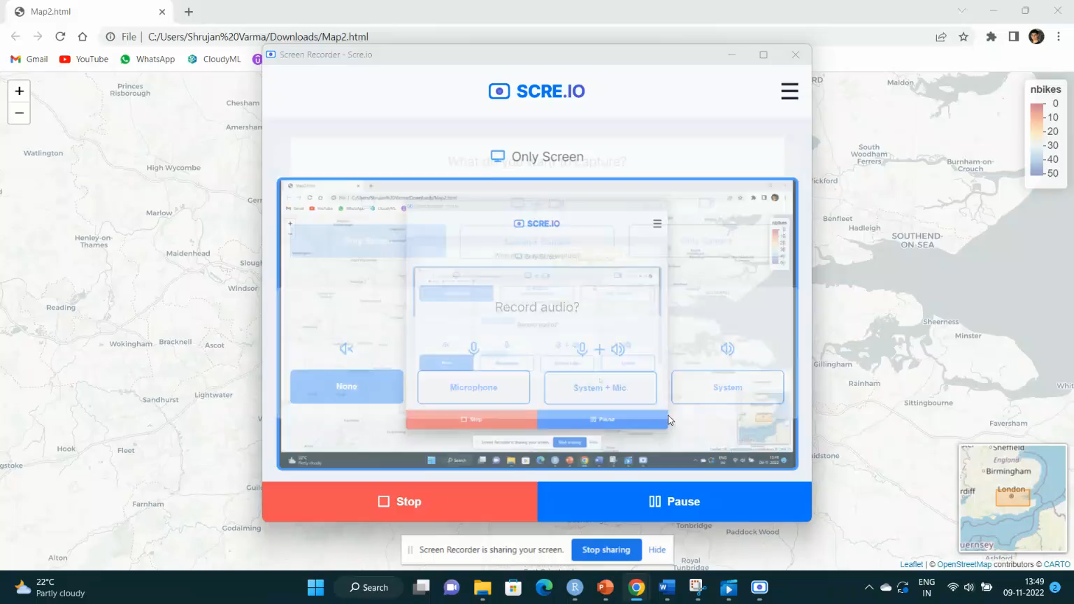

Slide 17
References :
Majority of the examples , packages and definitions have been picked up from:
Geocomputation with R by Robin Lovelace, Jakub Nowosad, Jannes Muenchow
https://bookdown.org/robinlovelace/geocompr/

